Slide 1

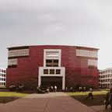


Human Values for Engineering Students
PUTTU GURU PRASAD
M.Com. M.B.A., L.L.B., M.Phil. PGDFTM, APSET. ICFAI TMF, (PhD) at JNTU K,
Associate Professor & Lawyer
S&H Department

Slide 2
A Prayer
“ I stretch it out to Thee with both arms
in a gesture of offering and I ask of Thee:
If my understanding is limited, widen it;
If my knowledge is obscure, enlighten it;
If my heart is empty of ardour, set it aflame;
If my love is insignificant, make it intense;
If my feelings are ignorant and egoistic, give them the full consciousness in the Truth”

Slide 3
Sanskrit Verse
“Udyamam, Sahasam, Dhairyam, Buddihih, Sakthi, Parakramahah, sadete yatra vartante tatra devah sahayakrt”(RIG VEDA SLOKA)
( where the six qualities of 1.Right Effort, 2.Enterprise, 3.Courage, 4.Know-how, 5.Resources, and the 6.Ability to Reshuffle Priorities Resides, there God lends a hand.)

Slide 4
DAKSHINA MURTHY STOTRAM – TELUGU
ఓం మౌనవ్యాఖ్యా ప్రకటితపరబ్రహ్మతత్వంయువానామ్
వర్శిష్ఠాంతేవసదృషిగణైరావృతం బ్రహ్మనిష్ఠైః |
ఆచార్యేంద్రం కరకలిత చిన్ముద్రమానందమూర్తిం
స్వాత్మరామం ముదితవదనం దక్షిణామూర్తిమీడే ||
చిత్రం వటతరోర్మూలే వృద్ధాః శిష్యాః గురుర్యువా |
గురోస్తు మౌనవ్యాఖ్యానం శిష్యాస్తుచ్ఛిన్నసంశయాః ||
ఓం నమః ప్రణవార్థాయ శుద్ధఙ్ఞానైకమూర్తయే |
నిర్మలాయ ప్రశాంతాయ దక్షిణామూర్తయే నమః ||
గురుర్బ్రహ్మా గురుర్విష్ణుః గురుర్దేవో మహేశ్వరః |
గురుస్సాక్షాత్ పరం బ్రహ్మా తస్మై శ్రీ గురవే నమః ||
నిధయే సర్వవిద్యానాం భిషజే భవరోగిణామ్ |
గురవే సర్వలోకానాం దక్షిణామూర్తయే నమః ||

Slide 5
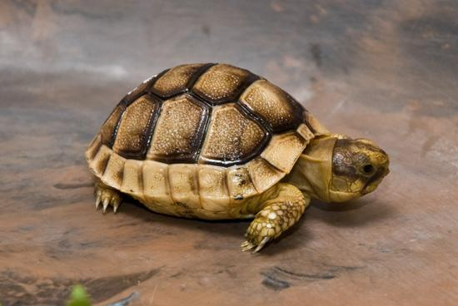
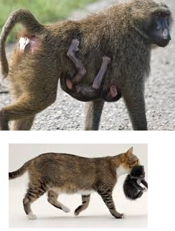
Guru Shishya Sambandham
Koorma Kishora Nyaya
(19-27)
Markata Kishora Nyaya (11-18Y)
Maarjaala Kishora Nyaya (1-10Y)

Slide 6

Human Values
Be a Lion not a dog
"When you throw a ball in front of the dog, it will run after the ball. When you throw something at the Lion its attention is still on you, not on the object you throw. It will be waiting to grab hold of you.
"Always focus on the source, not
the incidents, not the effects.
Go to the source"

Slide 7
Ethical Values
Keep life simple and enjoy what God has provided, without seeking false and expensive pleasures.

Slide 8
Gandhian Principles
Right Conduct - In accordance with accepted standards of moral or legal behavior and justice etc.,
Peace - to maintain or Refrain from disturbing law and order
Truth - the quality of being true, genuine, actual, or factual
Love - to have passionate desire, longing, and feelings for( Un conditional Love)
Non-Violence - abstention from the use of physical force to achieve goals (Restrain)

Slide 9
Thirukkural
“In sandy soil, when deep you delve, you reach the springs below; The more you learn, the freer streams of wisdom flow.”
― Thiruvalluvar,

Slide 10

Human Values
Words
Actions
Watch
Your
Thought
Character
Heart

Slide 11
Napoleon Bonaparte
Impossible is a word to be found only in the dictionary of fools.

Slide 12
A. P. J. Abdul Kalam
Small Aim is a Crime;
Have Great Aim.

Slide 13
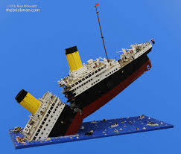
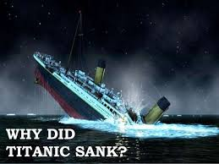
Engineering Ethics
Lack of ethics that led to the engineering disasters:
Over confidence- Titanic ship disaster

Slide 14
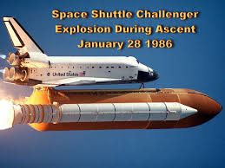
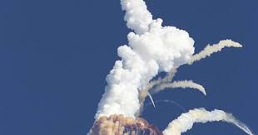
Lack of ethics that led to the engineering disasters:
Impatience: Space shuttle Challenger explosion

Slide 15
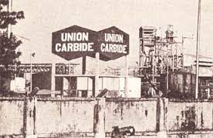
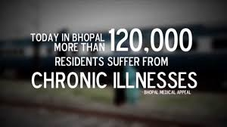
Lack of ethics that led to the engineering disasters:
Negligence and Poor maintenance – Bhopal Gas

Slide 16
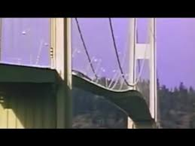
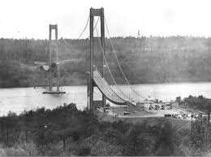
Lack of ethics that led to the engineering disasters:
Under Estimation- Tacoma Bay Bridge,

Slide 17
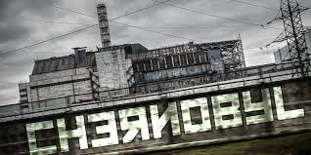

EMPLOYER BRANDING
Lack of ethics that led to the engineering disasters:
Ignorance of Potential dangers- Chernobyl disaster

Slide 18
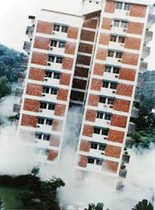
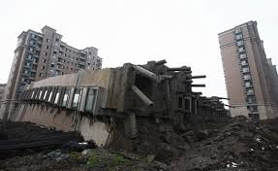
Highland Towers collapse
Laziness or the Failure to act

Slide 19
7 Deadly Sins
Envy = the desire to have an item or experience that someone else possesses
Gluttony = excessive ongoing consumption of food or drink
Greed = an excessive pursuit of material possessions
Lust = an uncontrollable passion or longing, especially for sexual desires
Pride = excessive view of one's self without regard to others.
Sloth = excessive laziness or the failure to act and utilize one’s talents
Wrath = uncontrollable feelings of anger and hate towards another person

Slide 20
12 UNIVERSAL HUMAN VALUES
Respect | 5. Responsibility | 9. Freedom
2. Compassion | 6. Integrity | 10. Peace
3. Honesty | 7. Tolerance | 11. Justice
4. Fairness | 8. Love | 12. Unity

Slide 21
10 Commandments
Exodus 20:3-17 verses
God wants us to feel good. He gave us commandments, or rules, to follow so we can live happier lives. Old Testament
“Thou shalt have no other gods before me.”
“Thou shalt not make unto thee any graven image.”
“Thou shalt not take the name of the Lord thy God in vain.”
“Remember the sabbath day, to keep it holy.”
“Honour thy father and thy mother.”
“Thou shalt not kill.”
“Thou shalt not commit adultery.”
“Thou shalt not steal.”
“Thou shalt not bear false witness against thy neighbour.”
“Thou shalt not covet.”

Slide 22
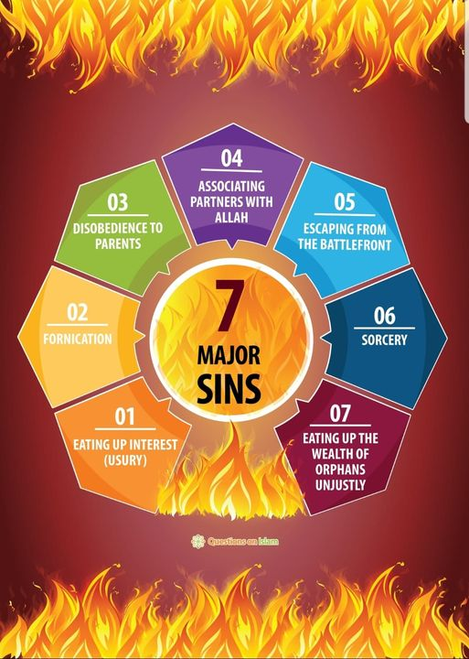
|| 7 Destructive Sins in Islam||

Slide 23

Best Human Qualities

Slide 24
UNIVERSAL HUMAN VALUES
"All great people of the world have tried to realize the truth and to live by it in terms of love and compassion.
They have tried to : Understand themselves (human being) Understand the underlying harmony in nature, in existence
They have tried to understand the role of the human being in nature, in existence, to live by it, and to develop an equitable and just society which ensures the wellbeing of all
For all such great people, we have a deep feeling of gratitude.“
https://uhv.org.in/

Slide 25


Slide 26


Slide 27
Thanking you All
Professor & Lawyer
Puttu Guru Prasad
Associate Professor
VVIT
Nambur, Guntur
puttuguru@vvit.net,
cell-93 94 96 98 98

